Slide 1
SASGSUB Macros SAS Grid Manager Client Utility with new SAS Grid Manager
David Glemaker
Principal Technical Architect
SAS Health Analytics Practice

Slide 2
SASGSUB Macros
Agenda
Why submit SASGSUB from SAS® Enterprise Guide®
Calling SASGSUB Macros in SAS® Enterprise Guide®
Admin Grid macros
Setup for SASGSUB Macros
Setup for Admin Macros

Slide 3
SASGSUB Macros
Why Submit gsub from SAS® Enterprise Guide®
Submit and forget (disconnect EGuide or from the network)
Frees up EGuide session
No client Install and config of Grid Manager and SASGSUB (everything stays on the server)
No need for shared file access between compute and client tier
No need for WinSSH and keys setup for each user for staging when Unix Server is SSH
Single client application access to SAS Grid (user only needs EGuide, no need to change interfaces to submit to SASGSUB)
Customers also like to submit these macros from SAS Studio and DMS
Disclaimer: These are not production macros delivered with SAS software, however, they are leveraging BASE SAS code. They have been tested on RHEL and might need slight changes for different O/S, versions, or shells. They have been implemented successfully at customers running on RHEL, Solaris, AIX and Windows.

Slide 4
SASGSUB Macros
Submitting gsub with EGuide
Macros for the SAS User Role
%mygsub %mygsubque
%gjobs and %gsstatus – reports on job status
%gsresults – move job results to a different directory
%gskill – terminate a gsub job
Macros for the SAS Admin role
%gjobs – reports on job status of all users
%bhosts – reports on Grid node status and number of jobs by machine
%bqueues - reports on queue priority, status, and number of jobs by queue
%lsload – reports on Grid node resources
%kill – terminates a grid job
%resume – resumes a suspended grid job
%suspend – suspends a grid job
Notes:
%mygsub, %gsstatus, and %gsresults require the setup steps in later slides to set the &gsconfigdir macro variable.
All Grid macros require xcmd to be enabled.
These are the main Grid macros users will use, lets discuss each on the next slides.
Admin macros require Grid Admin Client on the gridnodes and user must have an authinfo file in their home directory.

Slide 5
SASGSUB Macros
Submitting SASgsub with EGuide
%mygsub (/shared/apgm/sleep1.sas);
%mygsubque (mypgm=/shared/apgm/sleep1.sas,que=GS_normal);
Macro call for batch submission of gsub
SAS program residing on shared file system

Slide 6
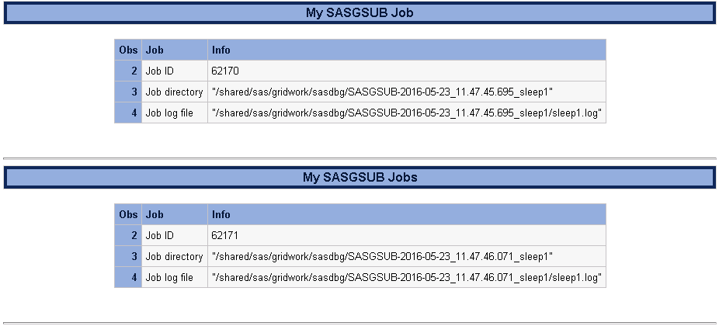
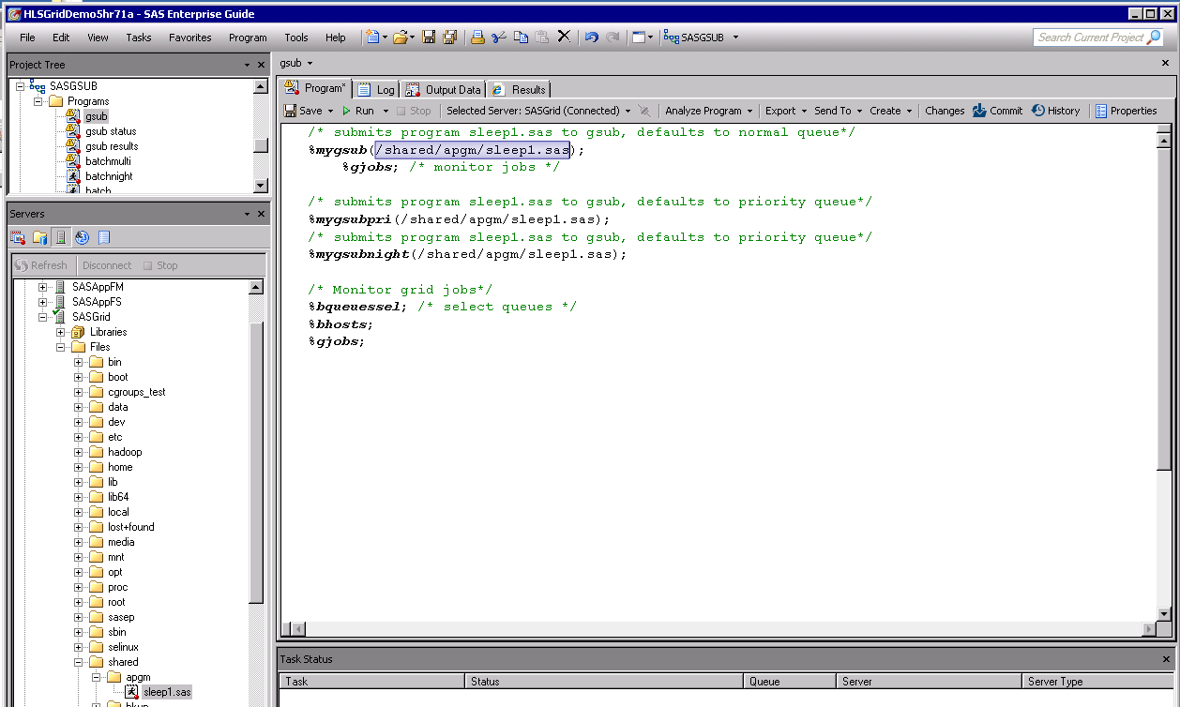
Submitting SASgsub with EGuide
Notes:
%mygsub results give jobid, job directory and job log. This example is the default locations of sasgsub to the Gridwork directory.

Slide 7
SASGSUB Macros
Grid Monitoring with EGuide
%gjobs;
Macro call for monitoring your grid jobs
Notes:
%gjobs show all Grid jobs for the user.

Slide 8
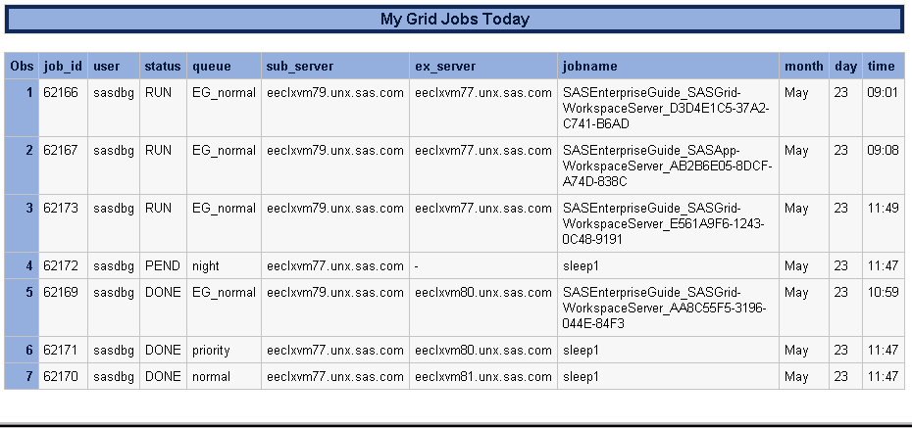
Grid Monitoring with EGuide
Notes:
%gjobs show all Grid jobs for the user including Grid launched sessions like EGuide, AMO, EM, DI, FS, etc.
Notice the job from mygsubnight is Pending while the others have already run and have a status of DONE and EGuide sessions are in status of RUN as expected

Slide 9
SASGSUB Macros
Grid Monitoring gsub jobs with EGuide
/* provide jobid for individual job or “all” for all gsub jobs */
%gsstatus(jobid=all);
Macro call for monitoring status of gsub jobs
Notes:
%gsstatus is designed to only show sasgsub jobs submitted not other Grid sessions like EGuide, DI, etc.
Show status for a specific jobid or “all” for all gsub jobs. “all” is the default if you just submit %gsstatus

Slide 10
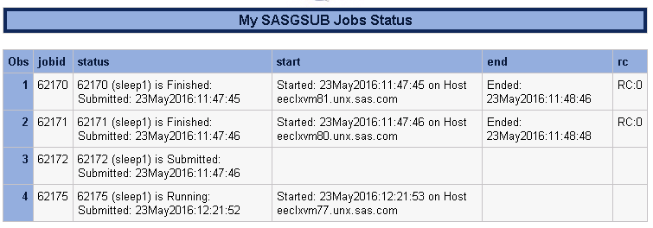
Finished
Pending
Night queue
Running
Notes:
%gsstatus is designed to only show sasgsub jobs submitted not other Grid sessions like EGuide, DI, etc.
Notice only the gsub jobs appear this time unlike the %gjobs.
This example also shows the results of jobs at various status
RC:0 means no errors

Slide 11
gsub Macros
Get results option for gsub
/* individual jobid or all */
%gsresults(jobid=all, mydir=/home/sasdbg);
Macro call for moving results/job directory of gsub jobs
Provide jobid for an individual job or “all” for all jobs (all is the default)
Provide new location to move results (must exist on shared file system)
Notes:
%gsresults is designed for users to move results/job directory to more suitable location than the default Gridwork directory.

Slide 12
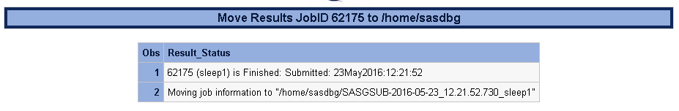
Get results option for gsub
Notes:
%gsresults is designed for users to move results/job directory to more suitable location than the default Gridwork directory.

Slide 13
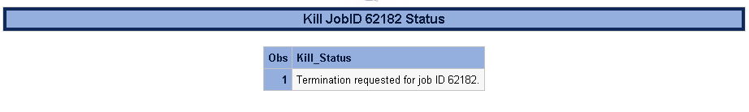
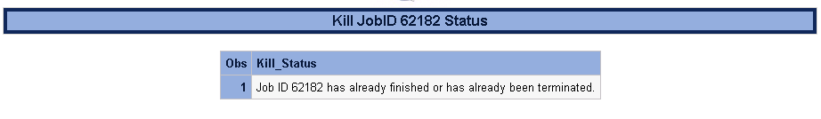
SASGSUB Macros
Killing gsub jobs with EGuide
/* provide jobid for individual job */
%gskill(jobid=1234);
Macro call for killing gsub job
Notes:
%gskill is designed to kill your gsub job.

Slide 14
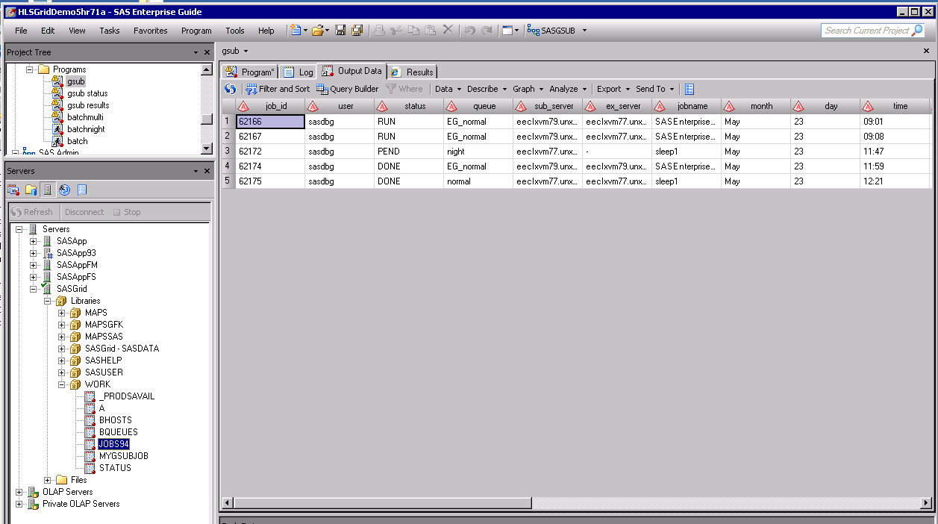
Notes:
Note these macros also create saswork tables for other uses if you need them.

Slide 15
SASGSUB Macros - Easily Customizable
%macro mygsub(mypgm);
options spool;
filename results pipe "&gsconfigdir./sasgsub -Gridsubmitpgm &mypgm";
data mygsubjob;
infile results dlm=":" missover truncover;
length Job $200. Info $200. info2 $200. ;
input Job Info Info2;
if substr(job,1,1) not in ("J") then delete;
if substr(info2,1,1) not in (" ") then info=compress(info)||":"||compress(info2);
run;
title "My SASgsub Job";
proc print data=mygsubjob; where info ne " ";
var job info;
run;
options nospool;
%mend mygsub;
Notes:
These macros are easily customizable for most SAS programmers. Edit the command in the filename statement and any parsing in the data step.

Slide 16
SASGSUB Macros
Submitting SASgsub with EGuide
SAS Admin Role Grid Macros
%gjobs;
Macro call for monitoring Grid jobs for all users when run as grid admin user
Notes:
%gjobsall show all Grid jobs.

Slide 17
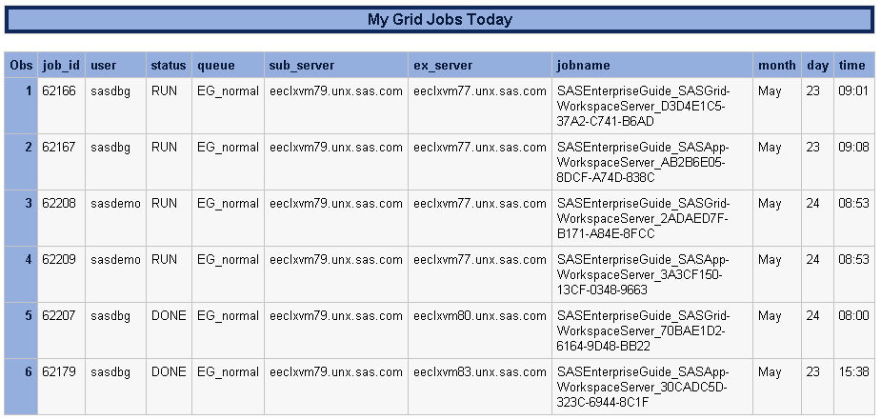
Notes:
%gjobsall shows all Grid jobs including Grid launched sessions like EGuide, AMO, EM, DI, FS, etc.

Slide 18
SASGSUB - SAS Admin Role Grid Macros
%bhosts;
Macro call for monitoring Grid servers
Notes:
%bhosts shows all Grid nodes status and number of jobs

Slide 19
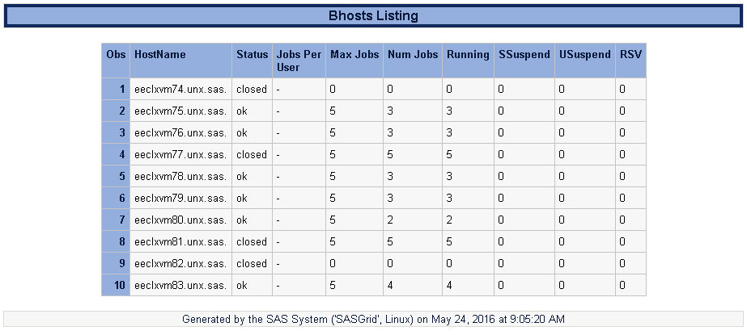
Notes:
%bhosts shows all Grid nodes status and number of jobs
Notice we have set max job slots to 0 on the the master, so it is in closed status, while other nodes are in closed status due to having 5 jobs running which meets their max job limit.

Slide 20
SASGSUB - SAS Admin Role Grid Macros
%bqueues;
Macro call for monitoring Grid queues
Notes:
%bqueues shows all Grid queues status and number of jobs

Slide 21
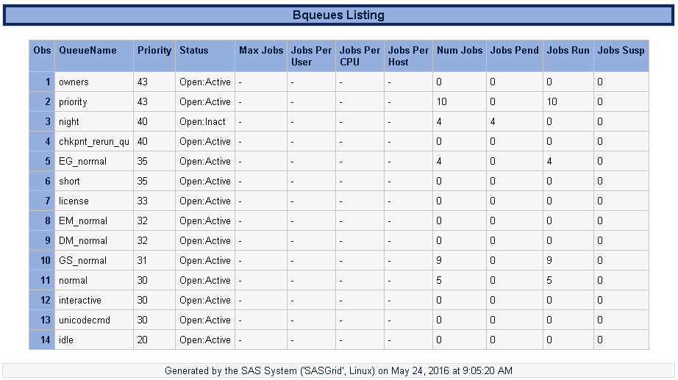
Notes:
%bqueues shows all Grid queues priority, status and number of jobs

Slide 22
SASGSUB Macros
Killing Grid jobs with EGuide
/* provide jobid for individual job */
%kill(jobid=1234);
Macro call for killing grid job
Notes:
%gskill is designed to kill your gsub job.

Slide 23
Notes:
%bqueues shows all Grid queues priority, status and number of jobs

Slide 24
SASGSUB - SAS Admin Role Grid Macros
%lsload;
Macro call for monitoring Grid node resources like CPU and Memory Utilization.
Notes:
%lsload and %lsloadl shows all Grid resources

Slide 25
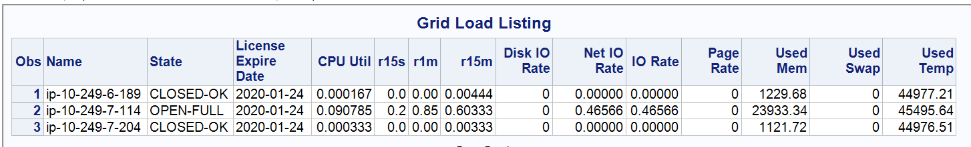
Notes:
%lsload shows all Grid resources

Slide 26
SASGSUB - SAS Admin Role Grid Macros
Required setup
If you like any of the previous macros then this is what you need to do to make them work in your environment.
Assumes sasgsub has previously been installed/configured on the clustered file system
Copy macros to SAS Grid shared file system
Edit appserver_autoexec.sas (add macro var for sasgsub config directory)
Validate sasgsub.cfg does not have _prompt_ for metapass
Set up Application Server Context
For file navigation to outputs
For xcmd permissions

Slide 27
SASGSUB Macros - Step 1: Extract zip file
Macros or .sas files should be copied to the following directory:
<SASConfigDir>/Lev1/SASApp/SASEnvironment/SASMacro
Alternatively if you want to provide macros to all Server Context then update
the <SASHOME>/SASFoundation/9.X/sasv9_local.cfg with below
-insert sasautos /sas/DGMacros
(/sas/DGMacros would be where you extract the macros. Any location on the
clustered file system will be fine.

Slide 28
SASGSUB Macros - Step 2: Edit appserver_autoexec.sas
Windows
i.e. C:\SAS\Config\Lev1\SASApp\appserver_autoexec_usermods.sas
Add: %let gsconfigdir=C:\SAS\Config\Lev1\Applications\SASGridManagerClientUtility\9.4;
Unix
i.e. /SAS/Config/Lev1/SASApp/appserver_autoexec_usermods.sas
Add: %let gsconfigdir=/SAS/Config/Lev1/Applications/SASGridManagerClientUtility/9.4;
Alternatively, if you want to provide macros to all Server Context then create/update
<SASHOME>/SASFoundation/9.4/autoexec.sas
Add: %let gsconfigdir=/SAS/Config/Lev1/Applications/SASGridManagerClientUtility/9.4;
The &gsconfigdir value should be the location of the sasgsub command:
Windows: sasgsub.cmd
Unix: sasgsub

Slide 29
SASGSUB Macros - Step 3:
Validate sasgsub.cfg does not have _prompt_ for metapass
Because we are using the xcmd, there cannot be any interactive windows popping up. The _prompt_ value for metapass would cause an interactive window to activate which we cannot interact with.
Open <SASConfgDir>/Lev1/Applications/SASGridManagerClientUtility/9.3/sasgsub.cfg
Navigate to Metauser and Metapass value
Enter a valid metadata user and password:
i.e.
-METAUSER sasgsub@saspw
-METAPASS {SAS002}1D57933958C580064BD3DCA81A33DFB2
or comment out:
/*-METAUSER sasgsub@saspw */ /* metadata server will honor session users authentication */
/*-METAPASS _prompt_ */

Slide 30
SASGSUB Macros - Step 4 a)
Set up Application Server Context - file Navigation
Because users may need to edit or create sas code, we want the file navigation to be set for locations the user can access.
In SAS Management Console
Expand Server Manager, SASApp, SASApp – Logical Workspace Server
Right Click SASApp - Workspace Server and Select Properties
Click the Options Tab
Click on the Advanced Options button
Click the File Navigation Tab and Click the Path radio button
Enter the desired start path, i.e. C:\sas\pgms or /sas/pgms. This location must exist on the compute tier shared file system.

Slide 31
SASGSUB Macros - Step 4 b)
Set up Application Server Context – XCMD Permissions
Because these macros need the xcmd capabilities, it must be enabled.
In SAS Management Console
Expand Server Manager, SASApp, SASApp – Logical Workspace Server
Right Click SASApp - Workspace Server and Select Properties
Click the Options Tab
Click on the Advanced Options button
Click the Launch Properties Tab
Check the Allow XCMD box
This requires refreshing spawner(s) or restarting the object spawner(s)

Slide 32
Admin - SAS Admin Role Grid Macros
Required setup
If you like any of the previous admin macros then this is what you need to do to make them work in your environment.
Assumes Grid Admin Client has previously been installed/configured on the clustered file system
Create Authinfo file in shared home directory
Set permissions on authinfo file

Slide 33
Admin Macros - Setup Steps
Edit .authinfo file in your home directory (note the . as the first character)
cd ~
vi ~/.authinfo
add the following:
default user <yourid> password <yourpassword>
Note that you can use proc pwencode for encrypted password values
Edit permission to protect the file
cd ~
chmod 600 ~/.authinfo
Validate permissions with the following command
ls –l ~/.authinfo
should look like below:
-rw------- 1 <yourid> <yourgroup> 67 Apr 4 17:39 /home/<yourid>/.authinfo
Notes:
Note: It is a requirement that the authinfo file be in UTF8 encoding.
“default” must be lowercase in the authinfo file.
If the customer has many users then these steps could be put into a SAS macro

Slide 34
Resources
SASGSUB Overview
SASGSUB commands
SASGSUB Syntax
Using the SAS Workload Orchestrator Administration Utility :: Grid Computing in SAS® 9.4, Fifth Edition
Authinfo File

